Slide 1


CMR TECHNICAL CAMPUS (Sponsored by CMR Technical Education Society, Reg.No: 1128/2007) UGC AUTONOMOUS Accredited by NBA& NAAC with ‘A’ Grade Approved by AICTE, New Delhi and JNTU, Hyderabad Kandlakoya (V), Medchal Road, Hyderabad - 501 401 Ph.No: 9247033440/41;www.cmrtc.ac.in; info@cmrtc.ac.in
ESTD: 2 0 0 9
COMPUTER SCIENCE AND ENGINEERING
Subject Name: OOPs through Java
Topic: Hospital management system
Group members:
J.SHIREESHA
MD.KAIF
M.RAJESHWARI
Under the guidance:
A. kiran kumar sir

Slide 2

HOSPITAL MANGEMENT SYSTEM

Slide 3
INTRODUCTION:
Hospital Management projects should have all the necessary requirements to full fill, the need to create a java project for the management staff of the hospital. This project should contain the doctor-patient table with all records. for example Doctor name, Timing speciality and availability. In this project, I cover 1. DOCTOR, 2. PATIENT, 3. MEDICAL, 4. LAB, 5. FACILITY, 6. STAFF tables. Now take an example of the Doctor table, I already saved some doctor details, when you select option 1. The doctors new entry 2.doctors list

Slide 4
EXAMPLE: Now take an example of the Doctor table, I already saved some doctor details, when you select option 1.new entry or 2. doctors list.
By pressing 1,we can update doctors details.
ID:
Name:
Specialization:
Working Time:
Qualification:

Slide 5
Doctors List: You can see the newly updated list of doctors and by pressing 2 you can see those details
ID | Doctor Name | Specialist | Timing | Qualification | Room No.
21 | Dr.Ghanendra | ENT | 10-04 | MBBS, MD | 17
32 | Dr. Vikram | Physician | 07-12 | MBBS | 45
17 | Dr Nistha | Child Specialist | 10-04 | MBBS, MD | 08
33 | Dr Pramod | Artho | 10-04 | MBBS | 40
17 | Dr Rekha | Artho | 08-12 | MBBS | 12

Slide 6
You can also check the patient list or you can admit new patients same as the Doctors List for that you have to go to the main menu and then select a patient then 2 options will occur 1. Add New Entry or 2. Existing Patients List and by pressing 2 you can check the patient details
ID | Patients Name | Disease | Gender | Admit Status | Age
12 | Pankaj | Cancer | Male | Y | 30
13 | Kuli | Cold | Male | Y | 23
14 | Samya | Malaria | Female | N | 45
15 | Ravi | Sugar | Male | Y | 25
Patients List:

Slide 7

Execution: In eclipse Project name: HospitalMangement
Package name: Hospital
Classes: doctor.class,
fecility.class,
hospitalmanagement.class,
lab.class,
medical.class,
patient.class,
and staff.class will be created.

Slide 8
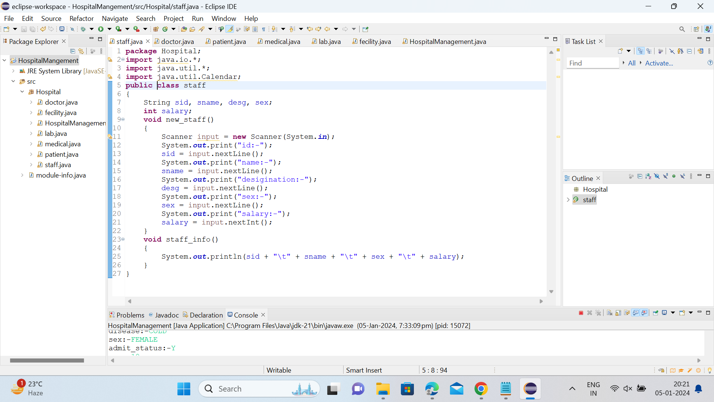

Slide 9
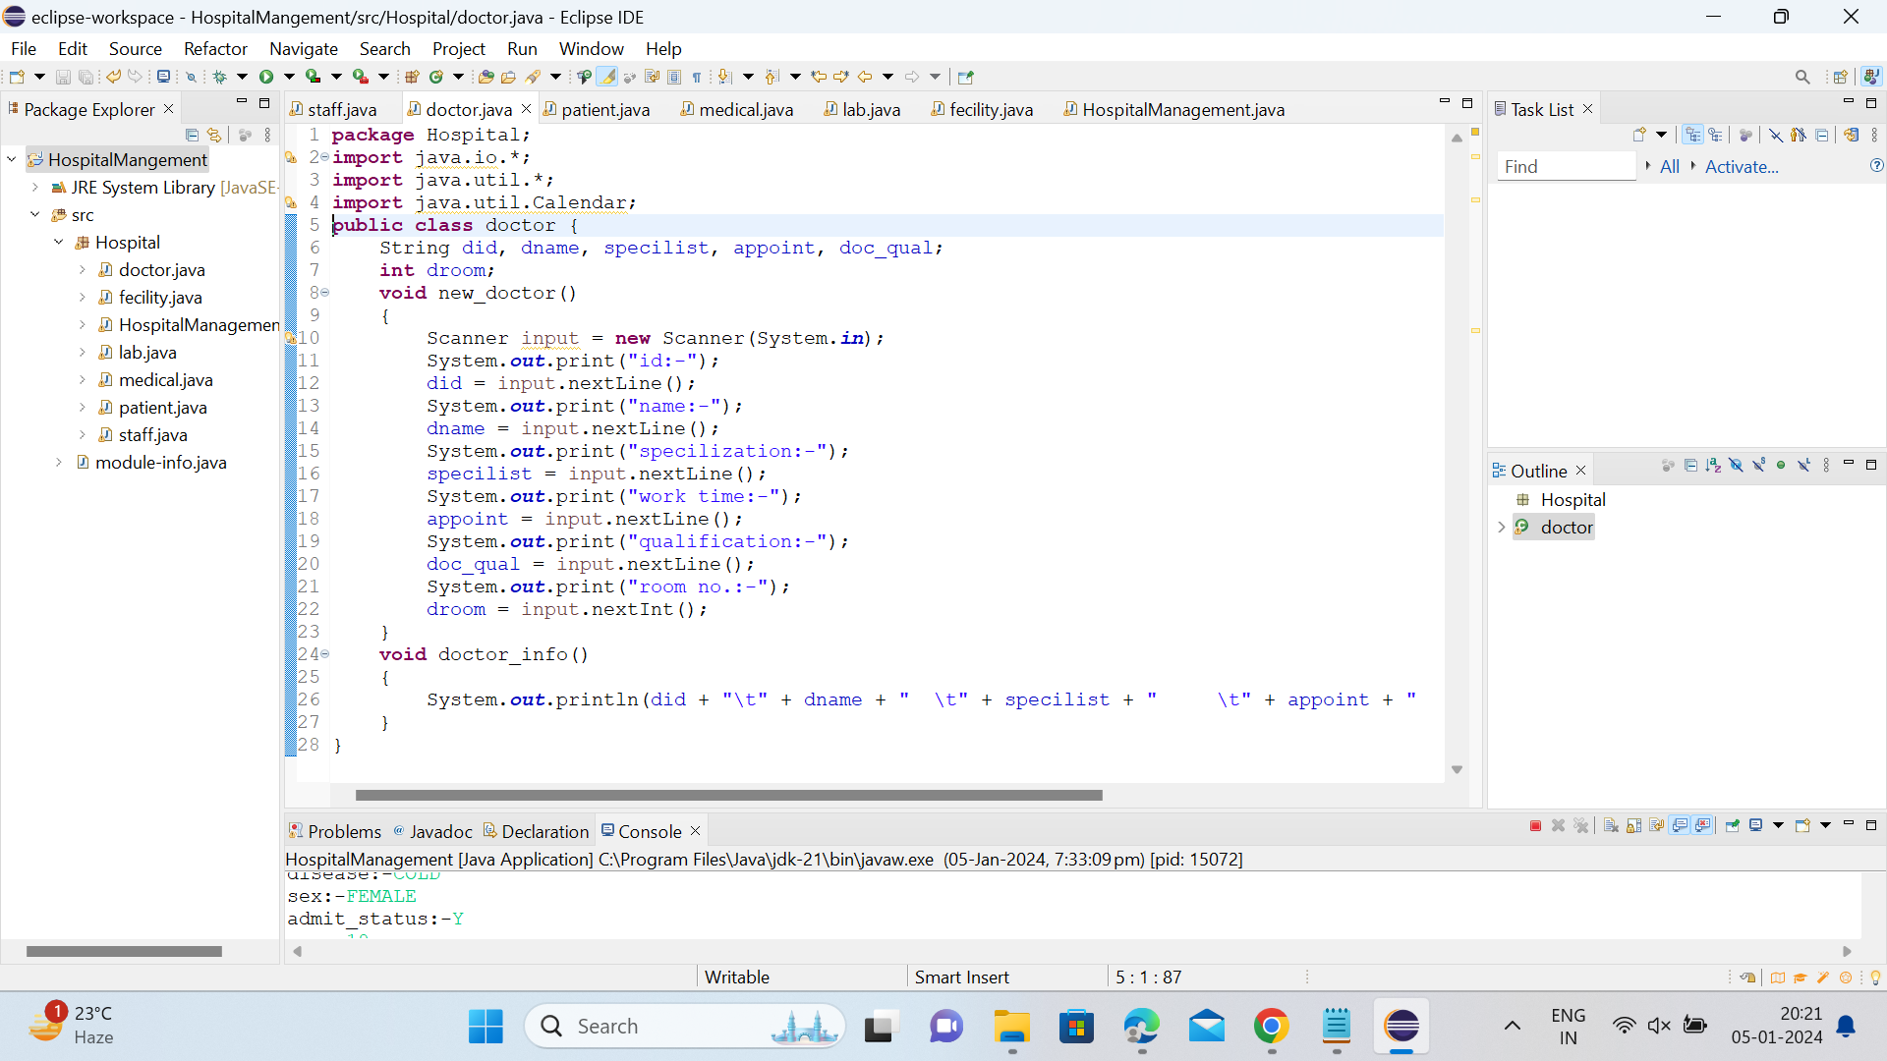

Slide 10
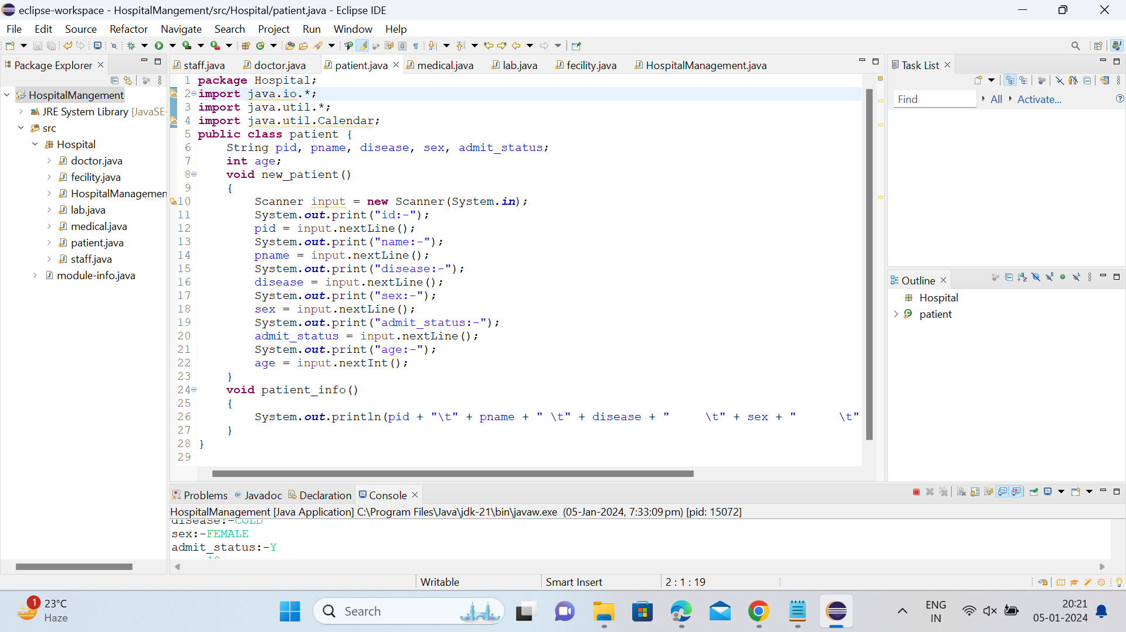

Slide 11
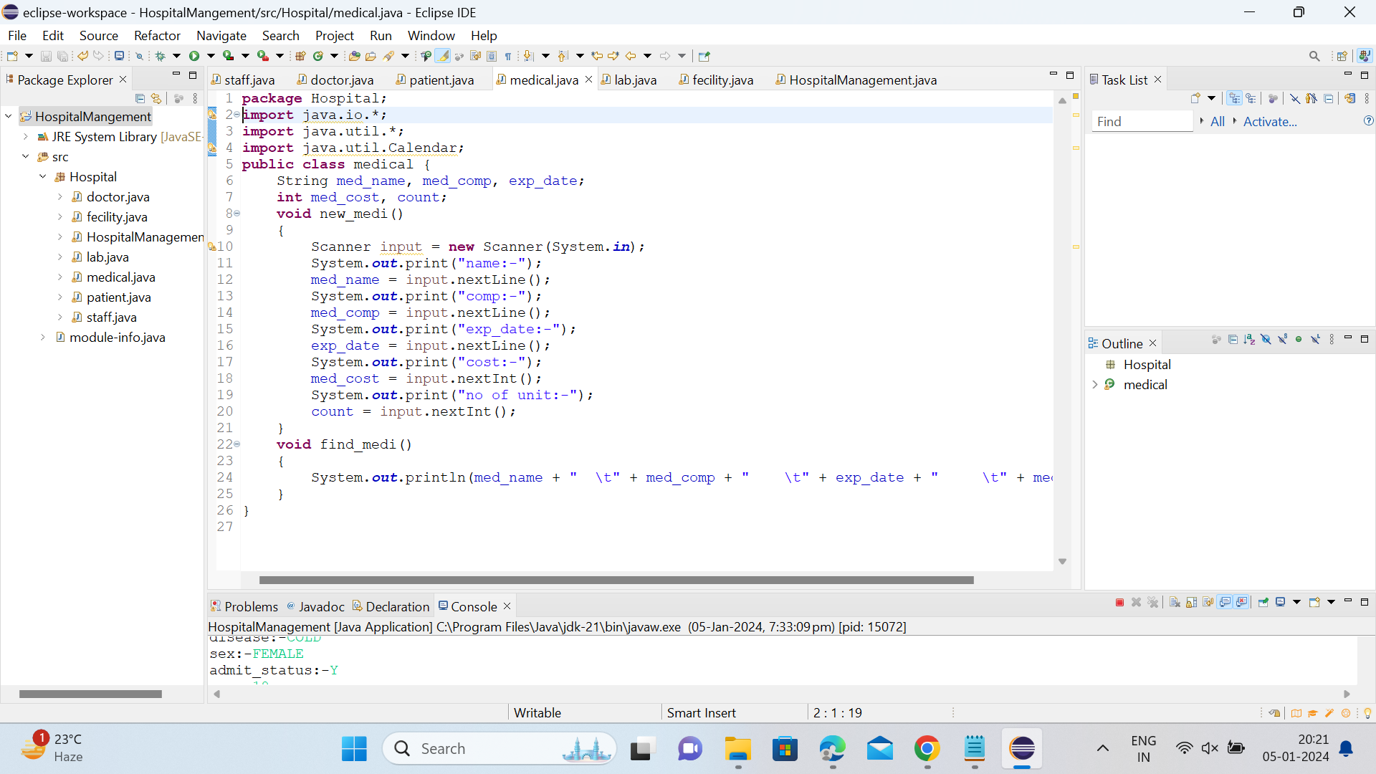

Slide 12
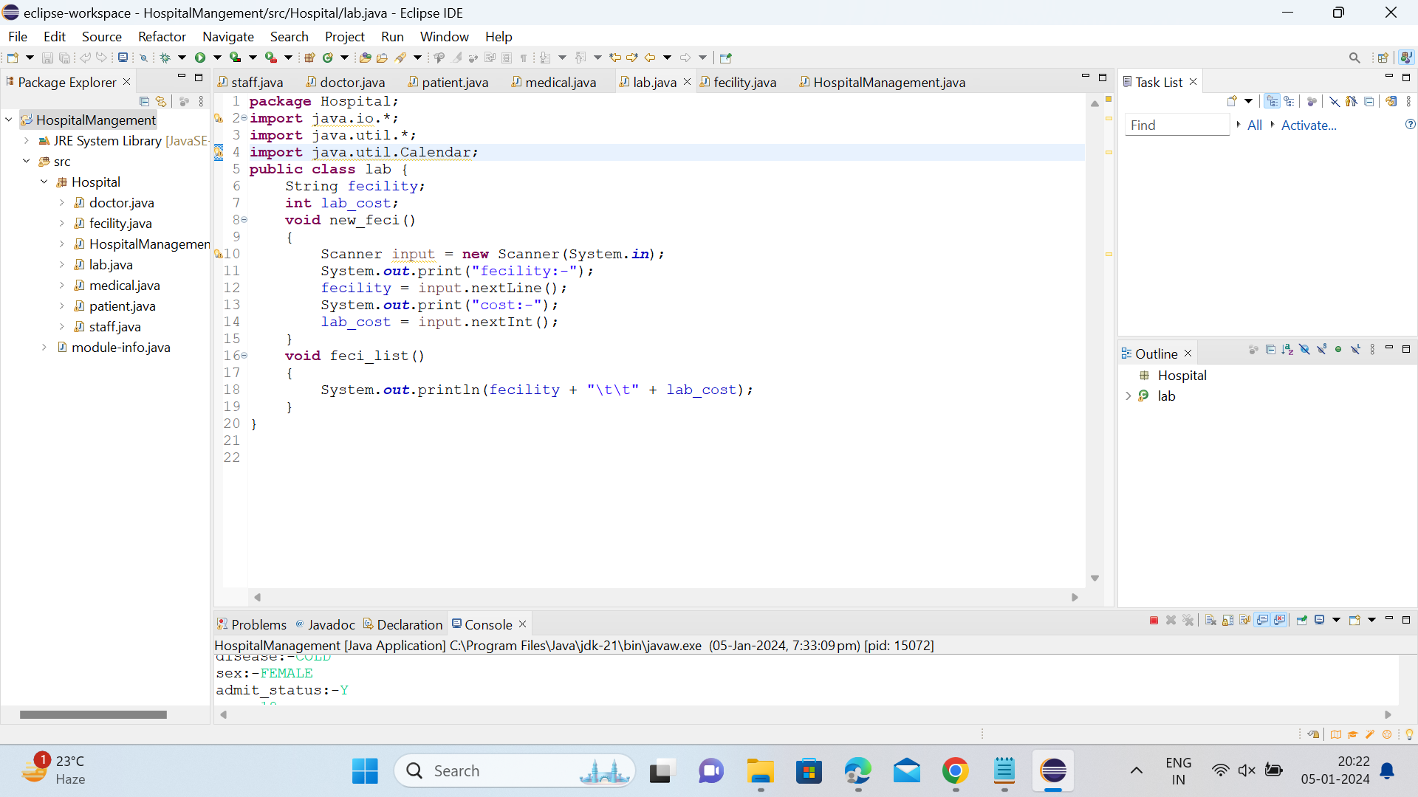

Slide 13
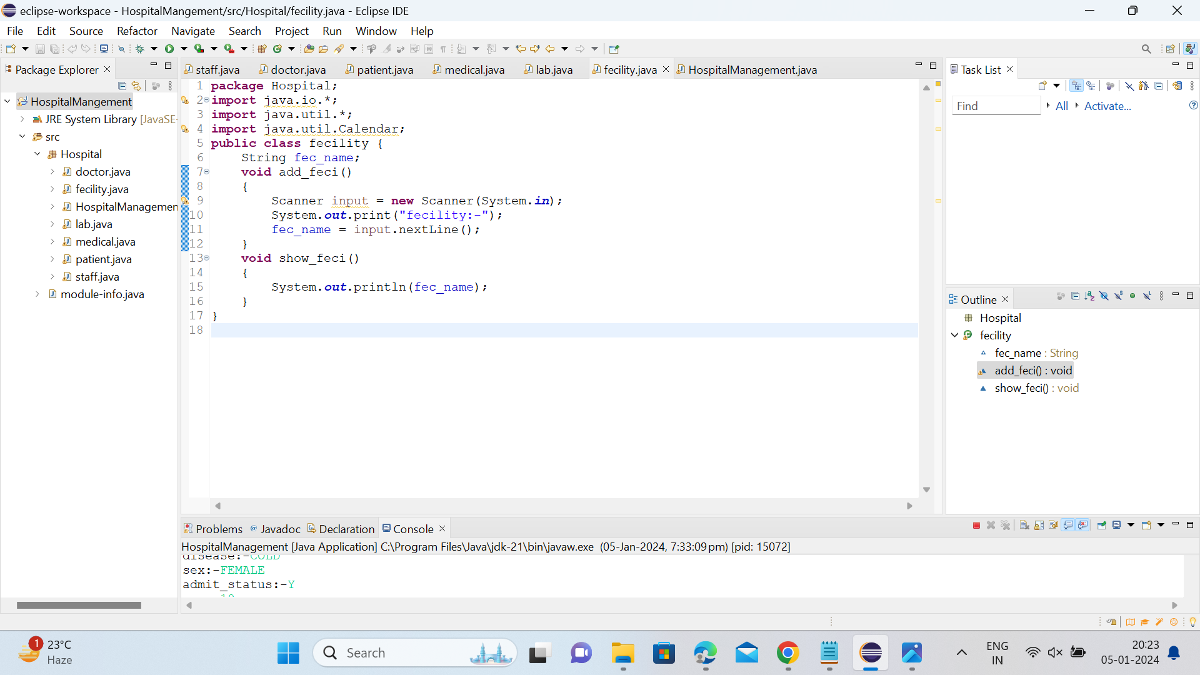

Slide 14
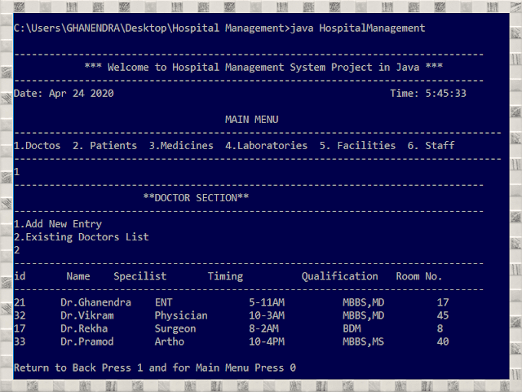
Output:
Doctors List in Hospital:

Slide 15
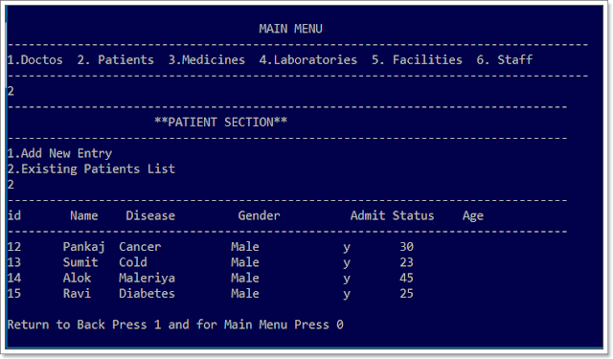
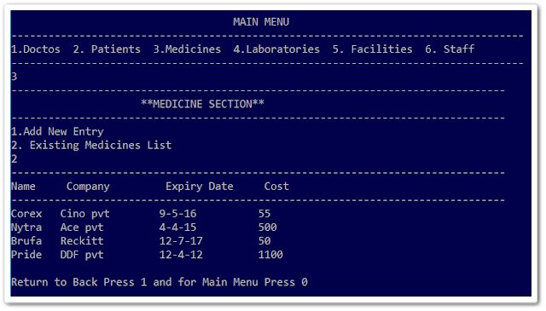
Patients List in Hospital
Medicines List in Hospital

Slide 16
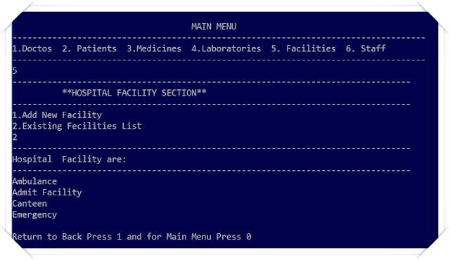
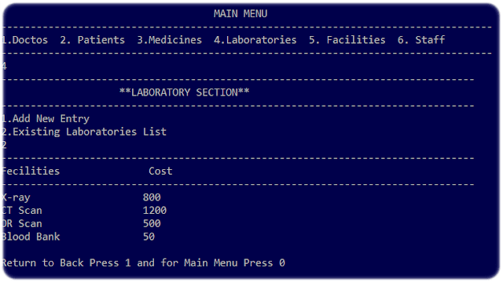
Laboratories List in Hospital
Facilities List in Hospital

Slide 17

Conclusion: This can be a powerful tool to help healthcare organizations improve their processes and streamline their operations. It can provide an integrated, comprehensive solution to managing patient records, billing and scheduling, as well as provide real-time insights into hospital performance.

Slide 18

THANK YOU

